Slide 1
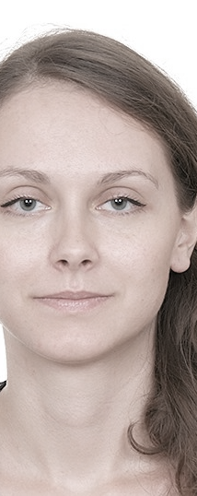
Katarina Milivojević
Data Analyst with four years of working experience with clients from various countries, and fields such as human resources, marketing, social psychology and medicine. Particularly skilled with Excel, SPSS, Python, R, and Tableau.
“If you torture the data long enough, it will confess.” — Ronald H. Coase

Slide 2



Projects
Covid-19 testing rate
    visualization with ggplot2 in R
Likelihood of woman having a third birth
    survival analysis in R
Post-millennials’ willingness to purchase products with GI
    structural equation modeling in SPSS AMOS
Effects of the type of Instagram endorser on the purchasing intentions of their followers
    survey experiment data analysis
Profile of the UK bank customers in different regions
    Tableau story

Slide 3
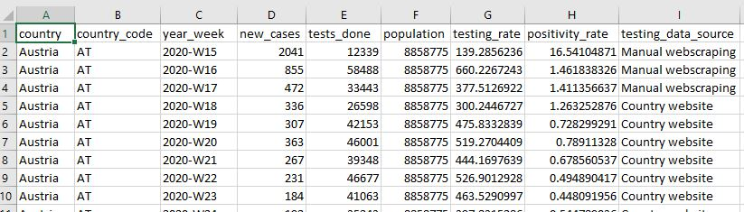
Covid-19 testing rate
How does testing rate changes in European countries over weeks, while taking positivity rate into account?
Data set: downloaded from European Centre for Disease Prevention and Control:
https://www.ecdc.europa.eu/en/publications-data/covid-19-testing
It was about testing for COVID-19 by week and by country, with 1099 observations.
Variable “positivity_rate” was obtained by dividing “new_cases” by “tests_done” * 100.

Slide 4
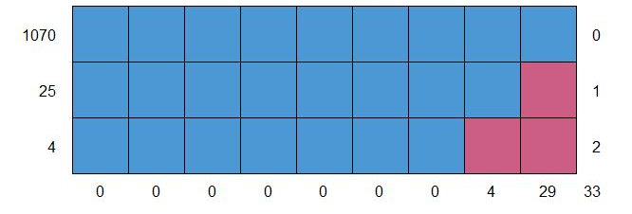
Covid-19 testing rate
How does testing rate changes in European countries over weeks, while taking positivity rate into account?
Data cleaning:
29 missing values in “positivity_rate” and 4 in “testing_data_source”
Monotone missing data pattern:
Rows with missing values were dropped, as they were all considering only first several weeks of the year, and the cells needed for calculating positivity rate were almost always zero.
Variable “year_week” was transformed by keeping only the week number and transforming it to numerical value.

Slide 5
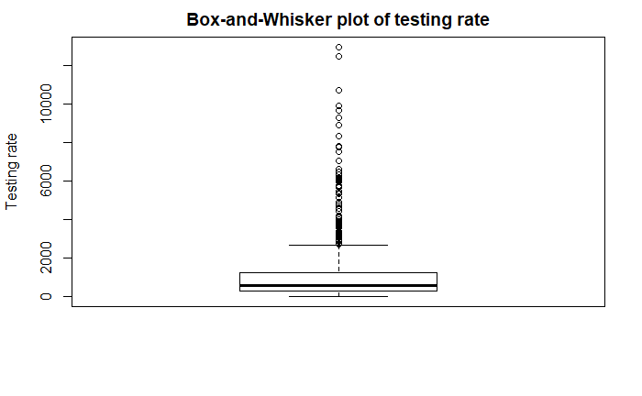
Covid-19 testing rate
How does testing rate changes in European countries over weeks, while taking positivity rate into account?
Descriptive characteristics of variable “testing_rate”
mean: 1011.25
median: 579.91
variance: 1 939 297
minimum: .05
maximum: 12 947.02
1st quartile: 271.13
3rd quartile: 1 233.90

Slide 6
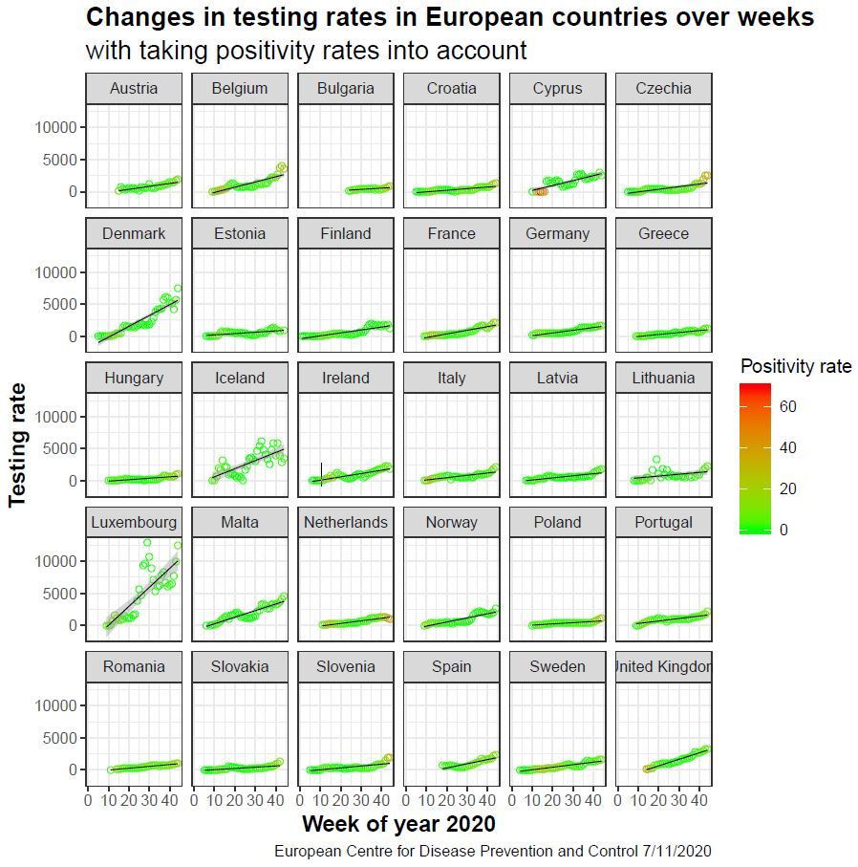
Covid-19 testing rate
How does testing rate changes in European countries over weeks, while taking positivity rate into account?
plot = ggplot(df, aes(x=df$year_week, y=df$testing_rate))
+ geom_point(shape = 1, aes(color = df$positivity_rate))
+ geom_smooth(method = lm, size = 0.3, color = 'black’)
+ scale_color_gradient(low='green', high='red’)
+ theme_bw() + facet_wrap(~df$country)
plot = plot + labs (
title = 'Changes in testing rates in European countries over weeks',
subtitle = 'with taking positivity rates into account',
caption = 'European Centre for Disease Prevention and Control 7/11/2020',
color = 'Positivity rate',
x = 'Week of year 2020',
y = 'Testing rate')
plot = plot + theme(plot.title = element_text(size = 15, face = 'bold'),
plot.subtitle = element_text(size = 15),
axis.title.x = element_text(size = 13, face = 'bold'),
axis.title.y = element_text(size = 13, face = 'bold'))
plot
pdf('plot.pdf')
print(plot)
dev.off()

Slide 7
Survival analysis
What is the effect of gender of first two children on the likelihood of a woman having the third birth?
Data set: Time to third birth data of the Medical Birth Registry of Norway, containing records of all births in Norway since 1967.
Downloaded from the selection of 16 116 cases from the initial data set (http://folk.uio.no/borgan/abg-2008/data/third_births.txt).
Variables:
age (age of mother at first birth in years),
spacing (time between first and second birth in days),
sibs (genders of the first two children, 1 = boy, boy, 2 = girl, girl, 3 = boy, girl, 4 = girl, boy),
time (time from second birth to third birth or censoring in days),
status (censoring indicator, 0 = censored, 1 = birth).
Right-censoring data.

Slide 8
Survival analysis
What is the effect of gender of first two children on the likelihood of a woman having the third birth?
Data preprocessing
No missing data
Adding variables:
  ID (unique identifier)
  spacing_months (time between 1st and 2nd birth in months; spacing divided with 30.5)
  time_months (time from 2nd to 3rd birth or censoring in months; time divided with 30.5)
Descriptive characteristics of the sample
age, M = 23.32, SD = 2.20
spacing_months, M = 32.61, SD = 14.02
10.9% (n = 1 761) women have given the third birth
time_months, M = 33.03, SD = 14.70
Genders | Frequency | Percent (%)
Boy, boy | 4 334 | 26.9
Girl, girl | 3759 | 23.3
Boy, girl | 4067 | 25.2
Girl, boy | 3956 | 24.5

Slide 9
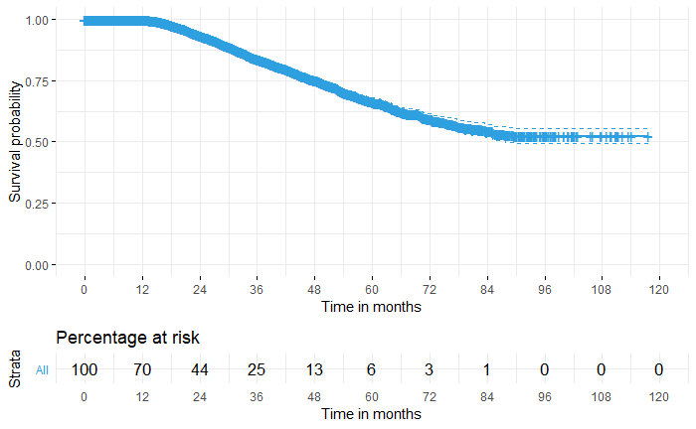
Survival analysis
What is the effect of gender of first two children on the likelihood of a woman having the third birth?
Objectives, methods, results
Comparing probability over time for having the 3rd birth after the 2nd birth later or not having it at all (survival probability) for combinations of the first two babies’ genders.
Kaplan-Meier estimator plots:

Slide 10
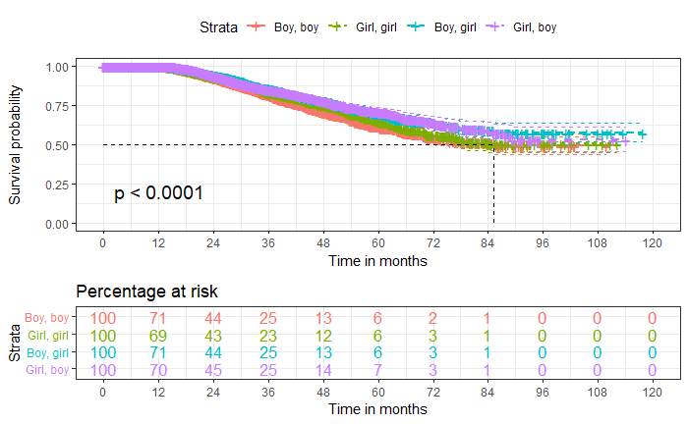
Survival analysis
What is the effect of gender of first two children on the likelihood of a woman having the third birth?
Objectives, methods, results
Comparing probability over time for having the 3rd birth after the 2nd birth later or not having it at all (survival probability) for combinations of the first two babies’ genders.
Log-rank test:
χ² (3) = 26.4, p = 8e-06
 |  | Weighted number of events (childbirth)
Genders | n | Observed | Expected
Boy, boy | 4 334 | 559 | 475
Girl, girl | 3 759 | 411 | 397
Boy, girl | 4 067 | 394 | 447
Girl, boy | 3 956 | 397 | 442

Slide 11
Survival analysis
What is the effect of gender of first two children on the likelihood of a woman having the third birth?
Objectives, methods, results
2. Estimating a model for a survival time (from 2nd to 3rd birth), with respect to age of the mother at first birth, time between 1st and 2nd birth and genders of the first two children.
Multivariate Cox regression
Predictor | Regression coefficients |  |  |  |  | 95.0% C.I. for Exp(B)
 | B | Exp(B) | Exp(-B) | S.E.(B) | Sig. | L.B. | U.B.
Age at first birth | .0049 | 1.0050 | 1.9951 | .0145 | .7341 | .9768 | 1.0339
Time from 1st to 2nd birth | -.0003 | .9997 | 1.0003 | .0001 | .0002 | .9996 | .9999
Boy, boy | .1174 | 1.1250 | .8892 | .06504 | .0711 | .9900 | 1.2774
Boy, girl | -.1671 | .8461 | 1.1818 | .0705 | .0178 | .7369 | .9716
Girl, boy | -.1477 | .8627 | 1.1592 | .0704 | .0359 | .7515 | .9903
N = 16 116, n of events = 1 761.
Abbreviations: B, regression coefficient; S.E., standard error; Sig., significance level; C.I., confidence interval; L.B., lower bound; U.B., upper bound.

Slide 12
Survival analysis
What is the effect of gender of first two children on the likelihood of a woman having the third birth?
Objectives, methods, results
3. Identifying the top ten women from the new unlabeled dataset of 500 who have the highest risk rates for having the third birth.
Rank | ID | Age at first birth | Time from 1st to 2nd birth (days) | Time from 1st to 2nd birth (months) | Gender | Risk score
1 | 308 | 23.3 | 381 | 12.49 | Boy, boy | .328
2 | 130 | 24.0 | 415 | 13.61 | Boy, boy | .323
3 | 386 | 19.8 | 357 | 11.70 | Boy, boy | .317
4 | 412 | 28.0 | 515 | 16.89 | Boy, boy | .316
5 | 370 | 19.2 | 361 | 11.84 | Boy, boy | .313
6 | 298 | 22.4 | 429 | 14.07 | Boy, boy | .311
7 | 205 | 26.6 | 507 | 16.62 | Boy, boy | .311
8 | 93 | 27.1 | 526 | 17.25 | Boy, boy | .308
9 | 37 | 20.7 | 411 | 13.48 | Boy, boy | .307
10 | 405 | 26.4 | 527 | 17.28 | Boy, boy | .305

Slide 13
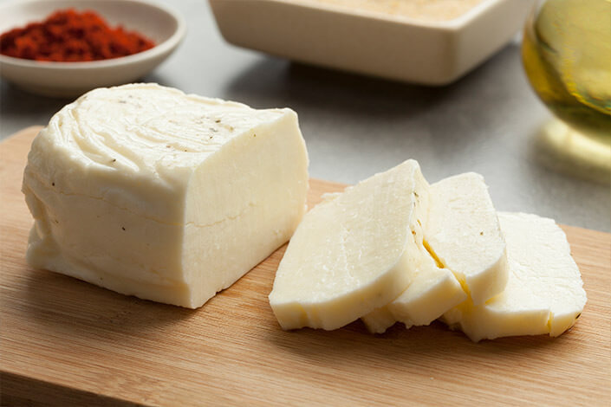
Structural Equation Modelling
Post-Millennials’ willingness to purchase products with geographical indications
Investigation on how
culture,
traditions,
health benefits,
perceived quality and safety, as well as
support to rural development
affects consumers’ willingness to purchase hellim / halloumi cheese with GI, and what is the mediating role of trust in GI in this relationship,
with specific interest in exploring these relationships among post-millennials.

Slide 14
Structural Equation Modelling
Post-Millennials’ willingness to purchase products with geographical indications
Data: survey data with 238 rows
Construct | Item | Statement
Culture and traditions | CT1 | Hellim with "Hellim/Halloumi" logo is a part of Cyprus culture
 | CT2 | For me it is important that hellim with "Hellim/Halloumi" logo is produced in traditional way
 | CT3 | Hellim with "Hellim/Halloumi" logo is made with traditional recipe
Health benefits | HB1 | I think hellim with "Hellim/Halloumi" logo is higher quality
 | HB2 | I think hellim with "Hellim/Halloumi" logo is more natural
 | HB3 | I think hellim with "Hellim/Halloumi" logo is healthier
 | HB4 | I think hellim with "Hellim/Halloumi" logo is tastier
Rural development | RD1 | By buying hellim with "Hellim/Halloumi" logo I support local community
 | RD2 | By buying hellim with "Hellim/Halloumi" logo I support local economy
 | RD3 | By buying hellim with "Hellim/Halloumi" logo I support local farmers
 | RD4 | By buying hellim with "Hellim/Halloumi" logo I contribute to preserve rural areas
Perceived quality and safety | PQS1 | Hellim with "Hellim/Halloumi" logo is better quality than other hellim offered in the market
 | PQS2 | "Hellim/Halloumi" logo secures that I am buying quality product
 | PQS3 | Quality and safety of hellim is certified by "Hellim/Halloumi" logo
 | PQS4 | Quality and safety of hellim is guaranteed by "Hellim/Halloumi" logo
Trust | T1 | I trust "Hellim/Halloumi" logo
 | T2 | "Hellim/Halloumi" logo is honest
 | T3 | "Hellim/Halloumi" logo is safe
Consumers’ willingness to purchase | CWP1 | I am willing to purchase hellim with "Hellim/Halloumi" logo
 | CWP2 | I am looking for hellim with "Hellim/Halloumi" logo in the markets
Caputo et al, 2011; Teuber, 2011; Mazodier, 2015; Lai, & Cheng, 2016

Slide 15
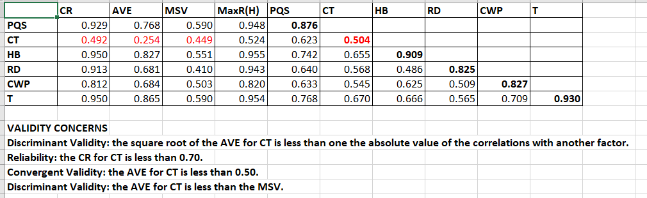
Structural Equation Modelling
Post-Millennials’ willingness to purchase products with geographical indications
Reliability, and convergent and discriminant validity of the constructs
Subscale | Cronbach’s α
Culture and traditions | .50
Health benefits | .95
Rural development | .90
Perceived quality and safety | .93
Trust | .95
Consumer’s willingness to purchase | .80
CR = Composite Reliability;
AVE = Average Variance Extracted;
MSV = Maximum Shared Variance;
MaxR(H) = McDonald Construct Reliability;
SQRT(AVE) on diagonal.

Slide 16
Structural Equation Modelling
Post-Millennials’ willingness to purchase products with geographical indications
Adequate measurement and structural model fit
RMSEA, root mean square error of approximation;
SRMR, standardized root mean residual;
AGFI, adjusted goodness of fit index;
NFI, Bentler-Bonett Normed Fit Index;
TLI, Tucker-Lewis index;
CFI, comparative fit index
 | Measurement model fit (RD5 excluded) | Structural model fit
χ2/df | 1.948 | 1.948
RMSEA | .063 | .063
SRMR | .042 | .042
AGFI | .844 | .849
NFI, TLI, CFI | > .90 | > .90

Slide 17
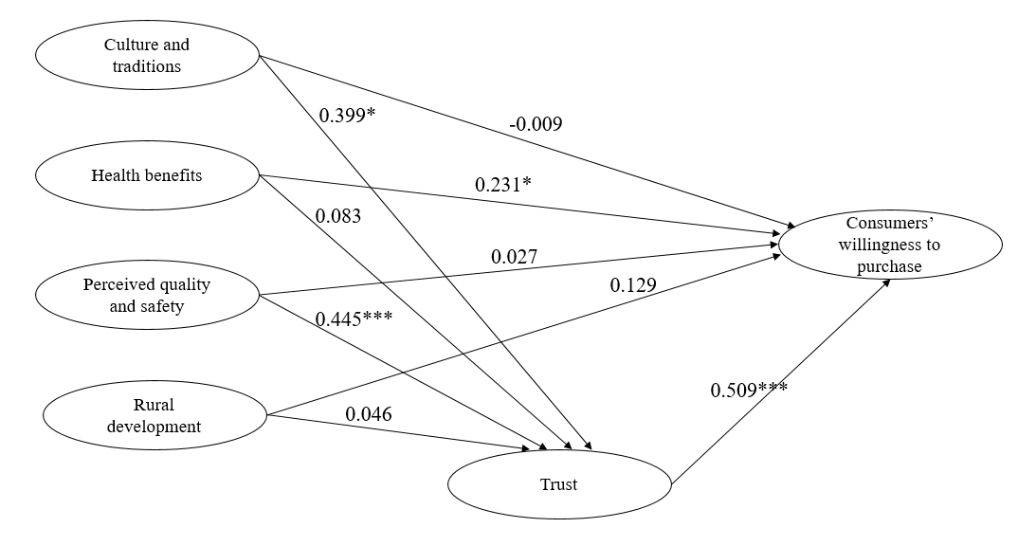
Structural Equation Modelling
Post-Millennials’ willingness to purchase products with geographical indications
Structural equation model
Mediation
1. Baron, & Kenny, 1986 (first two columns)
2. the bias-corrected bootstrap method with 10.000 samples at 95% confidence intervals (third column)
*p < 0.1, ***p < 0.001
Relationship | Standardized regression weights without mediator | Standardized regression weights with mediator | Standardized indirect effects
CT –> T –> CWP | 0.160 | -0.006 | 0.012**
HB –> T –> CWP | 0.222** | 0.246** | -0.074
PQS –> T –> CWP | 0.299*** | 0.028 | 0.072***
RD –> T –> CWP | 0.110 | 0.100 | -0.067
**p < 0.1
***p < 0.01

Slide 18

Survey experiment data analysis
Effects of the type of Instagram endorser on the purchasing intentions of their followers
Data: experimental survey data with 203 rows
Survey
4 groups:
  Celebrity
  Influencer
  Peer
  Control condition
4 photos of clothing, but each respondent saw only 1 photo of 1 piece of clothing
- Asked about their purchase intention
- Asked if they feel being influenced = persuasion knowledge
- Asked about their perception about the person (not asked for control condition)
- Asked about they are fashion-conscious
- Asked about their Instagram activity
- Asked about sex and age

Slide 19
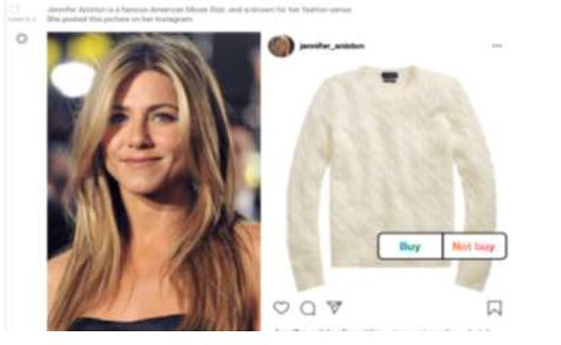
Survey experiment data analysis
Effects of the type of Instagram endorser on the purchasing intentions of their followers
Data: experimental survey data with 203 rows
Survey
4 groups:
  Celebrity
  Influencer
  Peer
  Control condition

Slide 20
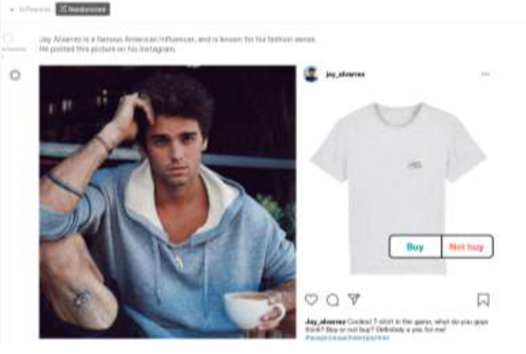
Survey experiment data analysis
Effects of the type of Instagram endorser on the purchasing intentions of their followers
Data: experimental survey data with 203 rows
Survey
4 groups:
  Celebrity
  Influencer
  Peer
  Control condition

Slide 21
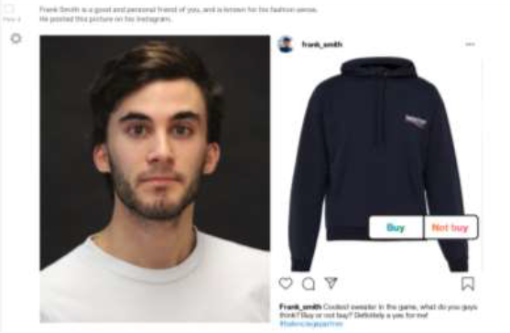
Survey experiment data analysis
Effects of the type of Instagram endorser on the purchasing intentions of their followers
Data: experimental survey data with 203 rows
Survey
4 groups:
  Celebrity
  Influencer
  Peer
  Control condition

Slide 22
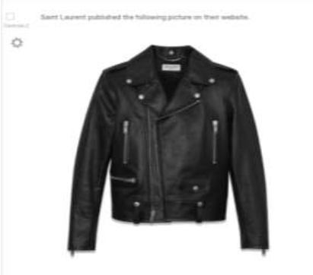
Survey experiment data analysis
Effects of the type of Instagram endorser on the purchasing intentions of their followers
Data: experimental survey data with 203 rows
Survey
4 groups:
  Celebrity
  Influencer
  Peer
  Control condition

Slide 23
Survey experiment data analysis
Effects of the type of Instagram endorser on the purchasing intentions of their followers
Data: experimental survey data with 203 rows
Survey
4 groups:
  Celebrity
  Influencer
  Peer
  Control condition
4 photos of clothing, but each respondent saw only 1 photo of 1 piece of clothing
- Asked about their purchase intention
- Asked if they feel being influenced = persuasion knowledge
- Asked about their perception about the person (not asked for control condition)
- Asked about they are fashion-conscious
- Asked about their Instagram activity
- Asked about sex and age

Slide 24
Survey experiment data analysis
Effects of the type of Instagram endorser on the purchasing intentions of their followers
Reliability of the scales (internal consistency)
Purchase intention (2), ρ = .91
Perception (6), α = .70
  Attractiveness (2), ρ = .72
  Expertise (2), ρ = .23
  Reliability (2), ρ = .89
Fashion consciousness (3), α = .82
ρ, Spearman-Brown split-half coefficient
α, Cronbach’s coefficient

Slide 25
Survey experiment data analysis
Effects of the type of Instagram endorser on the purchasing intentions of their followers
Equality of experimental conditions by gender and age
 | Gender
 | Female |  |  | Male |  |  | Total
Experimental condition | Mean | SD | N | Mean | SD | N | Mean | SD | N
Control | 23.82 | 2.519 | 22 | 26.00 | 3.212 | 26 | 25.00 | 3.087 | 48
Celebrity | 24.33 | 3.464 | 27 | 25.87 | 3.005 | 23 | 25.04 | 3.319 | 50
Influencer | 23.53 | 2.423 | 32 | 26.33 | 3.464 | 18 | 24.54 | 3.118 | 50
Peer | 23.93 | 5.298 | 28 | 24.53 | 3.289 | 19 | 24.17 | 4.560 | 47
Total | 23.89 | 3.594 | 109 | 25.71 | 3.239 | 86 | 24.69 | 3.550 | 195
SD, standard deviation.
Chi-squared test of independence:
no association between gender and experimental condition, χ² (3) = 3.63, p = .30
ANOVA of age:
effect of gender, F (1, 187) = 12.45, p = .001, partial η² = .06
no effect of group, F (3, 187) = .58, p = .63, partial η² = .01
no effect of gender × group, F (3, 187) = .85, p = .47, partial η² = .01

Slide 26
Survey experiment data analysis
Effects of the type of Instagram endorser on the purchasing intentions of their followers
Effects of the type of endorser on the purchase intention – ANOVA
Assumptions of normality and absence of outliers satisfied.
No between-subjects effect of group on purchase intention,
F (3, 195) = .68, p = .57.
Experimental condition | Mean | SD | SE | 95% Confidence Interval for Mean
 |  |  |  | Lower Bound | Upper Bound
Control | 3.19 | 1.133 | .160 | 2.87 | 3.51
Celebrity | 3.37 | 1.138 | .161 | 3.05 | 3.69
Influencer | 3.45 | 1.097 | .154 | 3.14 | 3.76
Peer | 3.48 | 1.096 | .158 | 3.16 | 3.80
Total | 3.37 | 1.113 | .079 | 3.22 | 3.53
SD, standard deviation. SE, standard error.

Slide 27
Survey experiment data analysis
Effects of the type of Instagram endorser on the purchasing intentions of their followers
Effects of the type of endorser on the persuasion knowledge (ordinal variable) – Kruskal-Wallis test
Significant effect of group on persuasion knowledge,
χ² (3) = 73.20, p < .001.
Mann-Whitney U test:
non-significant difference only between ’control’ and ’peer’ group (p > .05)
Experimental condition | Mean | SD | Mean rank
Control | 1.62 | .901 | 61.17
Celebrity | 2.90 | 1.093 | 121.91
Influencer | 3.45 | 1.137 | 142.35
Peer | 1.83 | .953 | 72.63
Total | 2.46 | 1.270
SD, standard deviation.

Slide 28
Survey experiment data analysis
Effects of the type of Instagram endorser on the purchasing intentions of their followers
Effects of the type of endorser on the perception – MANOVA (attractiveness, expertise and reliability as DVs)
Assumptions of sample size, univariate normality, multivariate normality, linear relationships among DVs, multicollinearity/singularity, equality of covariance matrices (Box’s test) – not importantly violated.
Assumption of equality of error variances not violated only for reliability (Levene: p > .05).
Solution: criterion for between-subjects effects tests was set at p = .01.

Slide 29
Survey experiment data analysis
Effects of the type of Instagram endorser on the purchasing intentions of their followers
Effects of the type of endorser on the perception – MANOVA
(attractiveness, expertise and reliability as DVs)
Multivariate tests:
significant effect of group, Pillai’s Trace = .51, F (6, 288) = 16.35, p < .001, partial η² = .25
Tests of between-subjects effects:
no effect of group on attractiveness, F (2, 145) = 3.09, p = .05, partial η² = .04
no effect of group on expertise, F (2, 145) = .14, p = .86, partial η² = .002
effect of group on reliability, F (2, 145) = 45.13, p < .001, partial η² = .38 (peer highest)
 | Perception dimension
 | Attractiveness |  | Expertise |  | Reliability
Experimental condition | Mean | SD | Mean | SD | Mean | SD
Celebrity | 3.95 | .970 | 3.26 | .777 | 2.93 | .742
Influencer | 3.75 | .751 | 3.25 | 1.036 | 3.00 | .728
Peer | 3.55 | .573 | 3.33 | .574 | 4.21 | .764
Total | 3.76 | .796 | 3.28 | .819 | 3.36 | .942
SD, standard deviation.

Slide 30
Survey experiment data analysis
Effects of the type of Instagram endorser on the purchasing intentions of their followers
Effects of persuasion knowledge, attractiveness, expertise, reliability, fashion consciousness, activity and gender on the purchase intention, when the type of endorser is controlled – multiple regression
Assumptions of sample size, multicollinearity/singularity, absence of atypical points, normality, linearity, homogeneity of variances, and independence of residuals were not violated.
IVs explained 61.3% of the variance of purchase intention,
R² = .61, F (10, 136) = 21.51, p < .001.

Slide 31
Survey experiment data analysis
Effects of the type of Instagram endorser on the purchasing intentions of their followers
Effects of persuasion knowledge, attractiveness, expertise, reliability, fashion consciousness, activity and gender on the purchase intention, when the type of endorser is controlled – multiple regression
 | Unstandardized Coefficients |  | Std. Coefficients | t | p | 95.0% C.I. for B
 | B | Std. Error | Beta |  |  | L.B. | U.B.
(Constant) | -.798 | .491 |  | -1.624 | .107 | -1.770 | .174
1. Celebrity | .327 | .191 | .127 | 1.713 | .089 | -.051 | .704
2. Influencer | .311 | .204 | .122 | 1.528 | .129 | -.092 | .715
3. Peer | -.069 | .209 | -.027 | -.332 | .741 | -.483 | .345
4. Gender | -.157 | .134 | -.070 | -1.173 | .243 | -.421 | .108
5. Persuasion knowledge | -.038 | .061 | -.043 | -.612 | .541 | -.159 | .084
6. Attractiveneess | .018 | .095 | .013 | .190 | .850 | -.170 | .206
7. Expertise | .293 | .089 | .216 | 3.298 | .001 | .117 | .469
8. Reliability | .228 | .108 | .193 | 2.108 | .037 | .014 | .441
9. Fashion consciousness | .680 | .097 | .515 | 7.011 | .000 | .488 | .872
10. Activity | -.024 | .061 | -.025 | -.396 | .693 | -.145 | .097
C.I., confidence interval; L.B., lower bound; U.B., upper bound.

Slide 32
Survey experiment data analysis
Effects of the type of Instagram endorser on the purchasing intentions of their followers
Effects of persuasion knowledge, attractiveness, expertise, reliability, fashion consciousness, activity and gender on the purchase intention, when the type of endorser is controlled – multiple regression
 | Unstandardized Coefficients |  | Std. Coefficients | t | p | 95.0% C.I. for B
 | B | Std. Error | Beta |  |  | L.B. | U.B.
(Constant) | -.798 | .491 |  | -1.624 | .107 | -1.770 | .174
1. Celebrity | .327 | .191 | .127 | 1.713 | .089 | -.051 | .704
2. Influencer | .311 | .204 | .122 | 1.528 | .129 | -.092 | .715
3. Peer | -.069 | .209 | -.027 | -.332 | .741 | -.483 | .345
4. Gender | -.157 | .134 | -.070 | -1.173 | .243 | -.421 | .108
5. Persuasion knowledge | -.038 | .061 | -.043 | -.612 | .541 | -.159 | .084
6. Attractiveneess | .018 | .095 | .013 | .190 | .850 | -.170 | .206
7. Expertise | .293 | .089 | .216 | 3.298 | .001 | .117 | .469
8. Reliability | .228 | .108 | .193 | 2.108 | .037 | .014 | .441
9. Fashion consciousness | .680 | .097 | .515 | 7.011 | .000 | .488 | .872
10. Activity | -.024 | .061 | -.025 | -.396 | .693 | -.145 | .097
C.I., confidence interval; L.B., lower bound; U.B., upper bound.

Slide 33
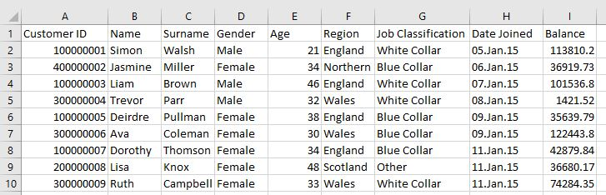
Tableau Story
Profiles of the UK bank customers in different regions
Data: data for an imaginary bank operating in the UK, 4 014 rows
https://www.kaggle.com/ukveteran/uk-bank-customers
Question: How the customers look like in the different regions of the UK?

Slide 34
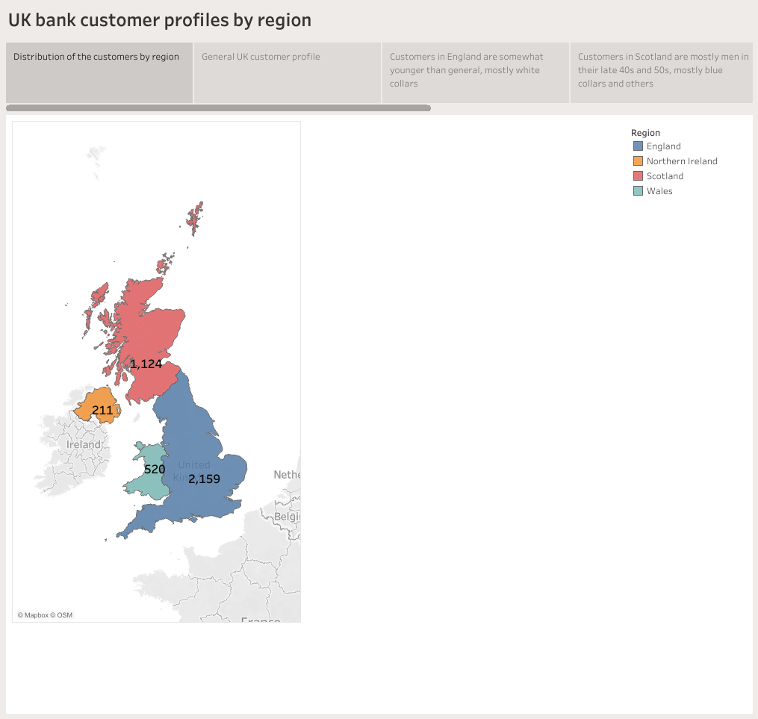

Slide 35
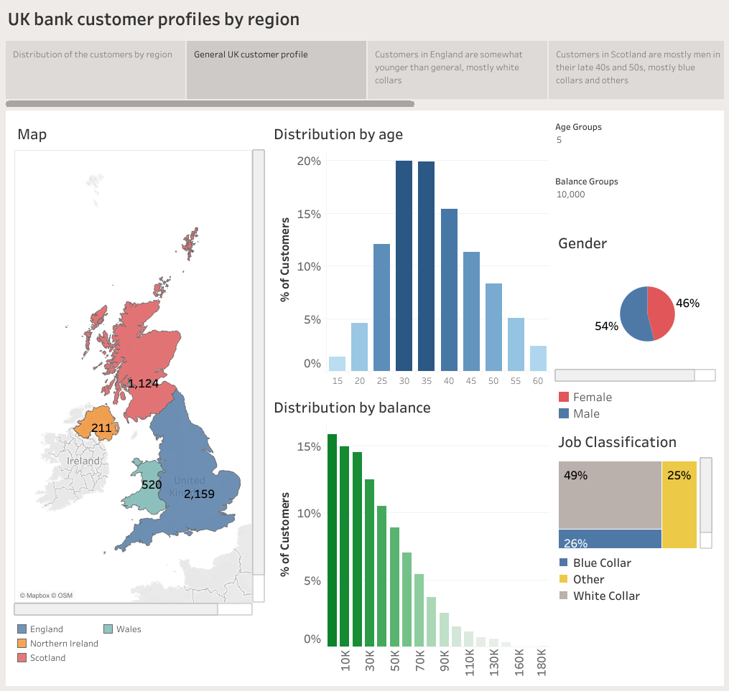

Slide 36
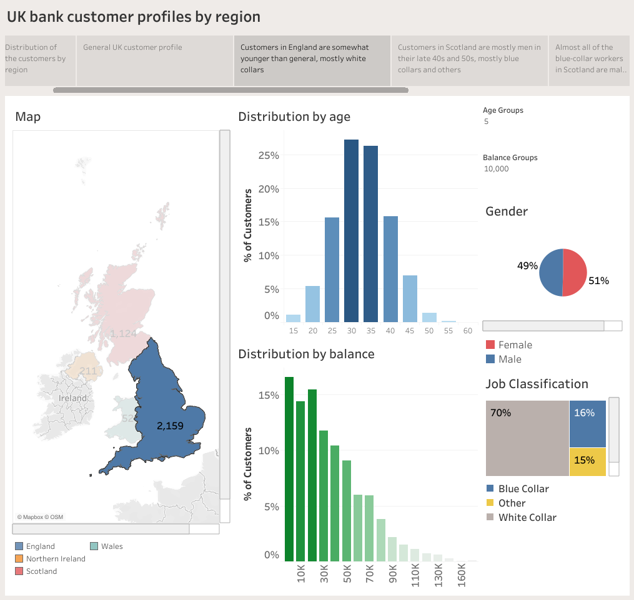

Slide 37
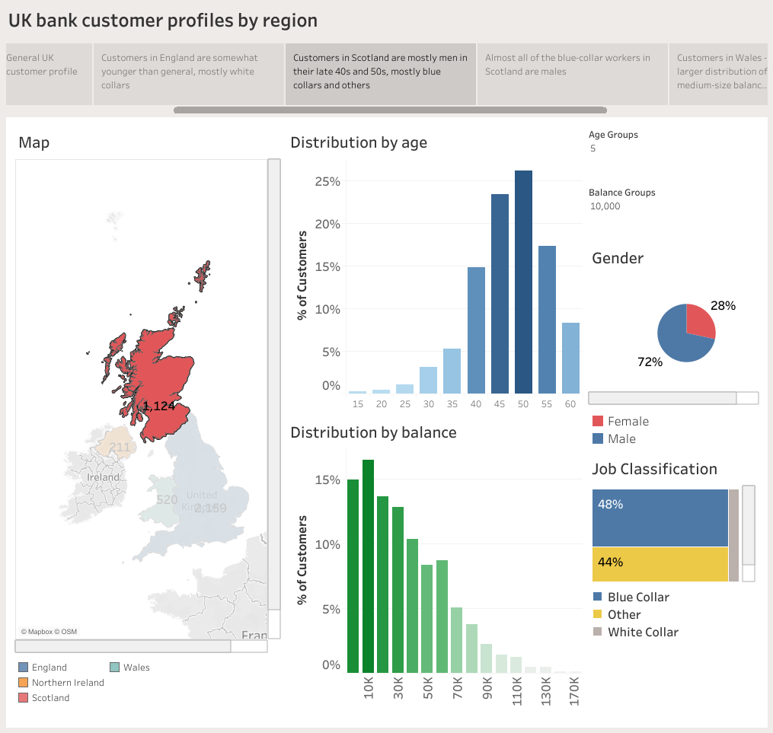

Slide 38
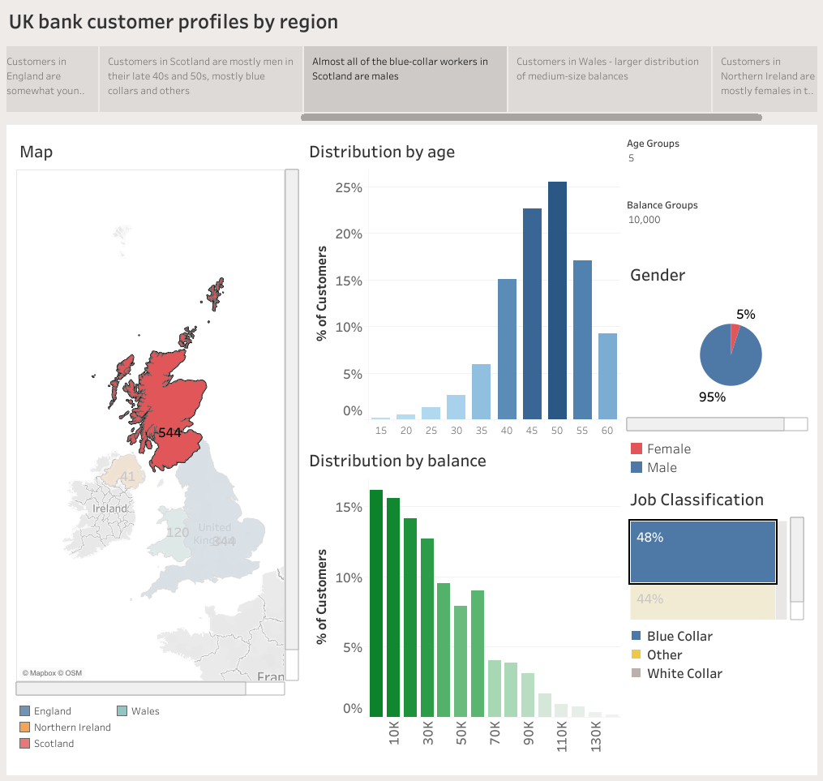

Slide 39
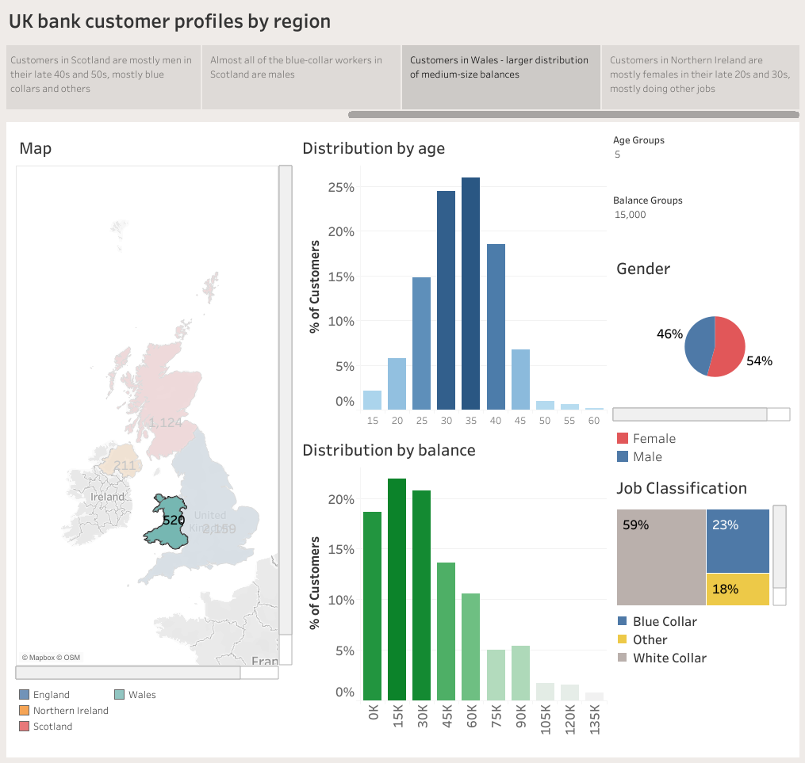

Slide 40
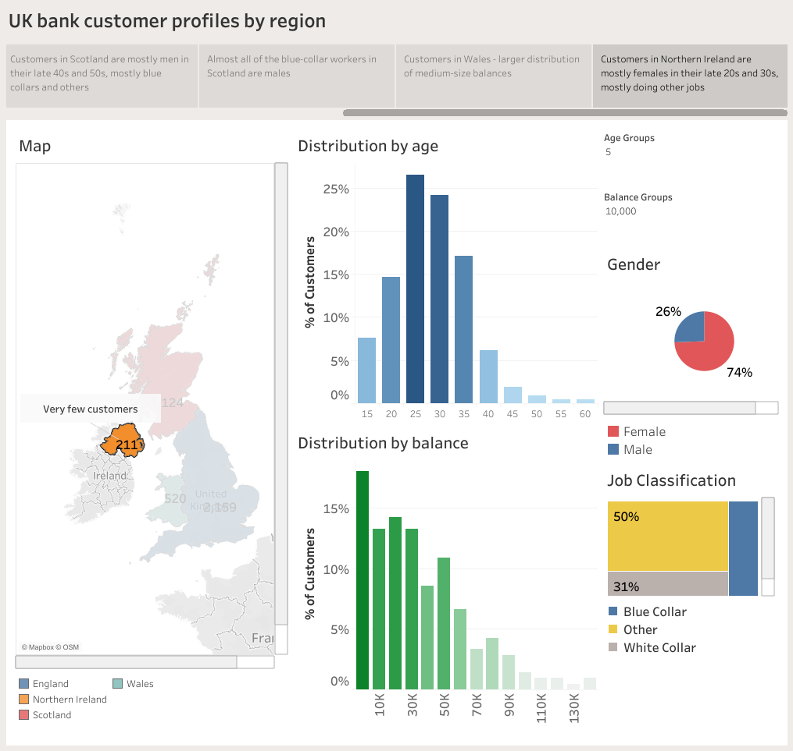

Slide 41
Thank you!

